Slide 1
Ecosystem for Smart Glass Technologies:
Proposal Presentation
January 20th, 2017
Najee Kitchens
Kairi Kozuma
Boa-Lin Lai
Jonathan Osei-Owusu
Nishant Shah

Slide 2
Agenda
Project Description and Goals
ESGT Overview
Background Research
Cost and Budget
Smart Mirror Features
Design Approach
Projected Schedule
Status
Accomplishment
Question and Answer

Slide 3
Project Description and Goals
ESGT: Ecosystem for Smart Glass Technologies
Objective
Create hardware and software ecosystem for all glass IoT devices
Extensibility to add support for any glass product
Motivation
Transparent IoT devices are not widespread yet
Difficulty implementing transparent technology
No commercial products readily available to the user at an affordable price
Smart Mirror will be prototype to demonstrate ESGT

Slide 4
ESGT Overview
Hardware Ecosystem
Transparent Display Technology
Interaction Interface
Software Ecosystem
Server Backend
API calls for retrieving data
Application Specific Modules

Slide 5
Background Research
Traditional capacitive touch with high sensitivity
Gesture recognition from images captured via stereoscopic sensor
TCOs for transparent circuitry
Inkjet printing for rapid prototyping
Floating Touch or
Gesture Recognition
Transparent Display Technology
Microcontroller
Wireless Connectivity
Wi-Fi to connect to the Internet
Offload computation to the cloud
Bluetooth for smartphone communication
Performance and power tradeoff
Powerful enough to drive large display, but efficient to run off battery

Slide 6
Cost and Budget (Prototype 1)
Table 1. Prototype 1 Equipment Costs
Component | Cost
Raspberry Pi™ 3 Model B | $35.00
Raspberry Pi™ Power Supply | $8.99
Two-Way Mirror | $72.00
Touchscreen LCD Monitor | $289.95
HDMI Cable | $0.00 (Received for free)
Total | $405.94
Notes:
MemoryMirror™ is similar. Uses mounted camera
We’ll use 2-way mirror instead ( lack of video rendering latency)
First prototype will be small scale (using LCD monitor as display, as opposed to bathroom-sized glass)

Slide 7
Cost and Budget (Prototype 2)
Table 2. Prototype 2 Equipment Costs
Component | Cost
Rectangular Annealed Glass | $20.11
Raspberry Pi™ 3 Model B | $0.00 (Reuse from Prototype 1)
Raspberry Pi™ Power Supply | $0.00 (Reuse from Prototype 1)
Conductive Silver Ink | $0.00 (Received for free)
HDMI Cable | $0.00 (Received for free)
Inkjet Printer | $0.00 (Received for free)
Total | $20.11
Notes:
We’ll do Prototype 2 after finishing Prototype 1
This one will feature glass + transparent display circuitry (from inkjet printer)
We’d sell finalized product for ~$400, yielding ~$160 in profit

Slide 8
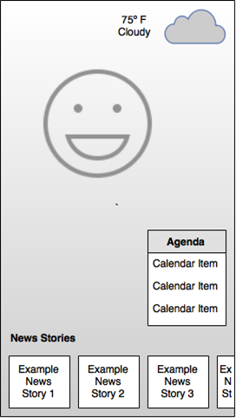
Smart Mirror Features
Display weather, agenda, news, and other relevant information
Smartphone application to set up and configure the smart mirror
Won’t obstruct user figure when smart mirror is displaying information
Appearance of a regular mirror when display is off

Slide 9
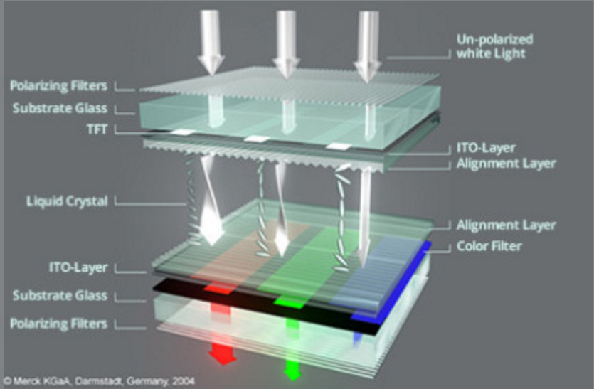
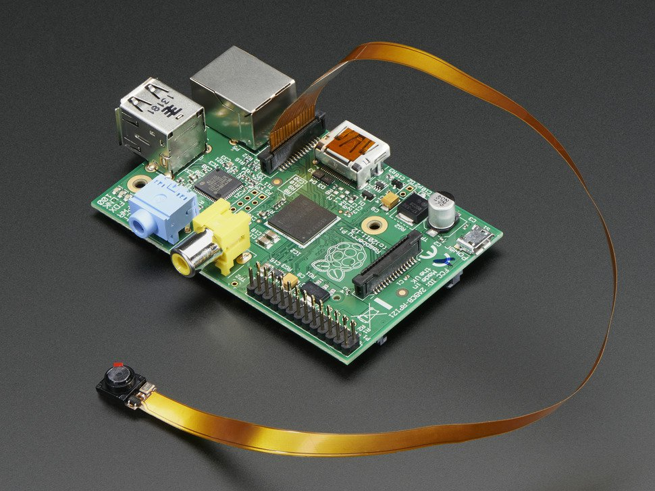
Design Approach (Hardware)
Translucent Display
Adhere behind mirror
User interaction
Touch Screen
Floating capacitive touch
Gesture Sensor (leap motion)
Interaction with mirror with gestures
Notes:
Boa, Najee

Slide 10
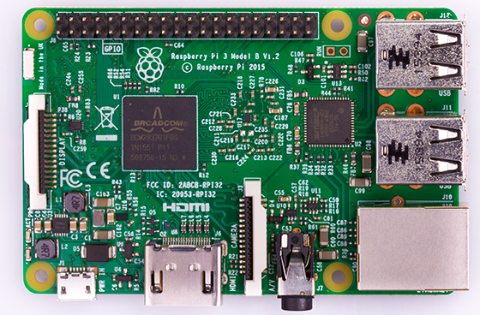
Design Approach (Microcontroller)
Raspberry Pi 3 Model B
4 USB ports
40 GPIO pins
Full HDMI port
A 1.2GHz 64-bit quad-core ARMv8 CPU
802.11n Wireless LAN
Bluetooth 4.1
Bluetooth Low Energy (BLE)
Micro SD card slot
Notes:
We can talk about why we choose this modules.
// hdmi, wifi, blueto

Slide 11
Design Approach (Software)
User Interface
Mirror GUI will be implemented using HTML and CSS
Flexibility and portability to different systems.
Add interactivity using javascript
Backend
Python and Ruby for computation and communication with phones and other peripherals
Module API
Allow more UI components to be added easily
UI and Backend will have a module framework with an API
Database
Local database to cache data retrieved from various sources
Notes:
Nishant, Najee
GUI
HTML, CSS
Javascript
Modular
Backend
Communicate via Bluetooth/Internet

Slide 12
Design Approach (Software)
Backend code will connect and send or retrieve data from peripheral devices
Phone
Main source for personal data such as calendar and email
Sensors (GPS) can give contextual information about the user
Communication through bluetooth or Wi-Fi
Leap Motion
Additional source of direct user input through gestures
Communication will be through a direct USB connection

Slide 13
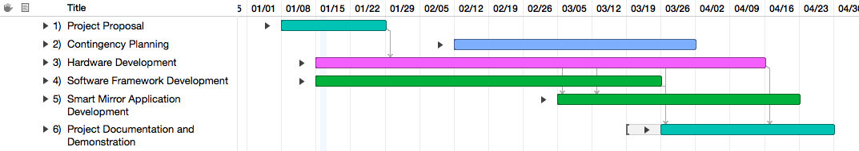
Projected Schedule
Simplified Gantt chart
Hardware and software development done in parallel
Use simple prototype to allow software team to get started
Work on software framework, common to all glass IoT devices
Hardware team implements transparent display technology
Shift towards software when smart mirror application development begins
Ample time for project documentation and demonstration

Slide 14
Status
List all the needed parts for Smart Mirror Project
Will place an order for prototype parts (week of 1/23-1/27)
Collect feedback of project ideas from advisor and survey samples
Notes:
Boa

Slide 15
Accomplishment
Survey
Project specification
Break Off Into Teams
Hardware
Assemble parts
Configuration on I/O
Software
Backend Server (database)
UI design
Analyzing data from sensors
Module API
Notes:
Talking about roles

Slide 16
Question and Answer

